Slide 1


Artificial Intelligence Guild
AIG-07 Midpoint Code Review
January 2021

Slide 2
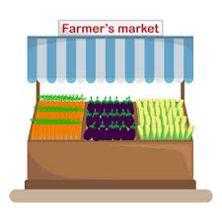
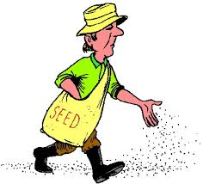




Crop Yield Prediction - Overview
This project would help in predicting the production of crops in a farming season which would help farmers to plan sowing process according to market requirements, manage logistics, etc.
Notes:
TD

Slide 3
Capstone Project Approach Summary
Please describe the data you are using, key analysis and EDA, and what the final product was / is and the accuracy.
Data Sources
Key Fields
Model Results
https://data.gov.in
Groundwater data http://cgwb.gov.in/
Crop Production History https://www.aps.dac.gov.in
Geographical / Weather - NASA Power
Groundwater
Area
Min. Temperature
Max. Temperature
Surface Pressure
Precipitation, etc.
TBD
Notes:
TD

Slide 4
Capstone Project Data Pathway
Please show how your data moves from raw to model ready – include any major steps such as feature engineering, grouping, binning, encoding categorical features, PCA, autoencoders, NLP, etc. Be detailed! Add more bubbles!
Dataset
Data Cleansing
Feature Engineering
Feature Selection
Model
Ensemble
Notes:
TD

Slide 5
Capstone Project Next Steps
Regression Analysis / Modelling
Model Training
Model Evaluation
Model Deployment
Notes:
TD

Slide 6
Appendix – Code Snippets
Include code snippets with explanation (if necessary) to explain slide 3
Notes:
TD

